Slide 1

Intro to
Programming
With python
Iteration:
transforming Images
Monday, March 10 2025 TOH210
Notes:
Layout objects pulled from: https://slidesgo.com/
All icons are from: https://thenounproject.com/

Slide 2
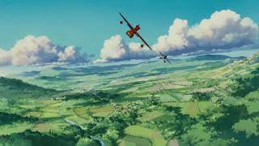
transforming Images
Worksheet
click for access
found on Moodle under this week
grab from back table
Grab pixel_moo.gif and move_the_moo.py from Moodle to follow along with the worksheet

Slide 3


WARMUP
green and black
import _________
#set up blank image with width 200 and height 300
img = image.____________(200, 300)
#grab colors to use
green = image.______(0, 255, 0)
black = image.______(__ , __ , __ )
#color left rectangle
for col in range(0, 100):
for ___ in range(____ , ____):
img.setPixel(col, row, ________)
#color right rectangle
for col in range(____ , ____):
for ___ in range(0,300):
img.__________(col, row, black)
win = image.ImageWin(“Green and Black”, 200, 300)
img.______(win)
image
EmptyImage
Fill in the blanks on your worksheet to make the program on the left create the image below:
Pixel
0
0
0
Pixel
row
0
300
green
100
200
row
setPixel
draw

Slide 4

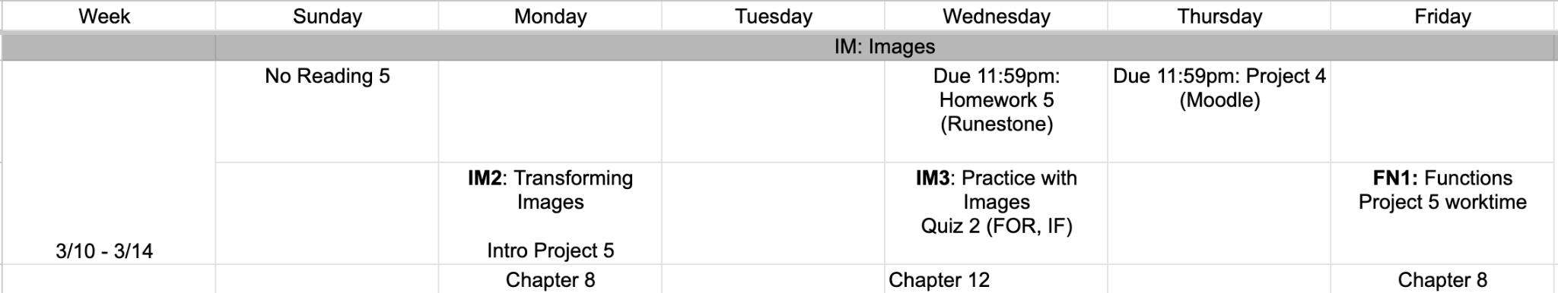
this week
google sheet link

Slide 5
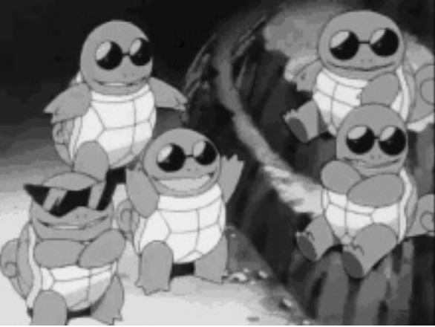
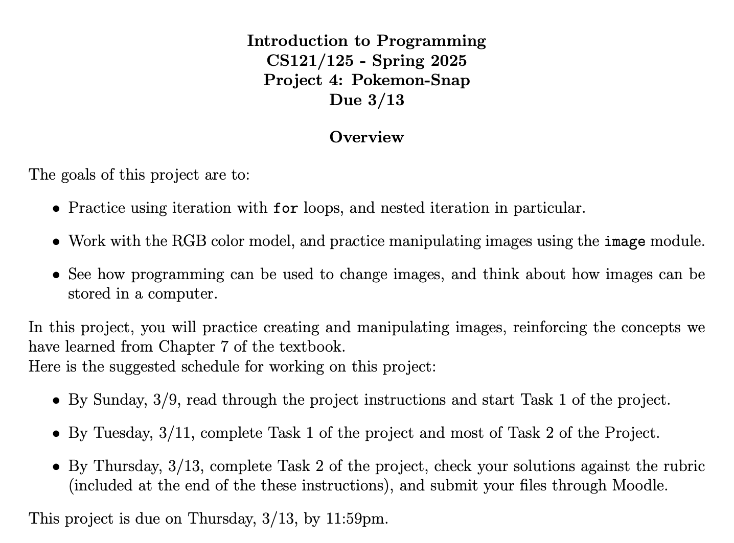

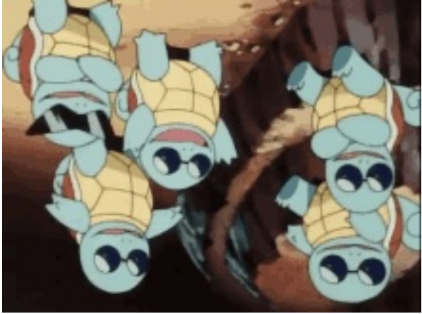
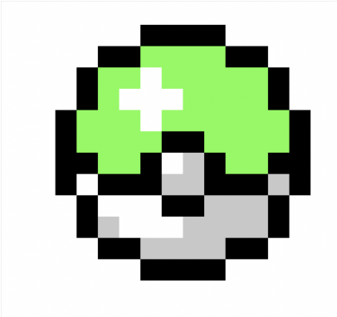
Task 2
Task 1
extra credit

Slide 6
Takeaways from last time
Things you should know:
images as grid of pixels
colors represented as RGB values
module image.py
create empty image, select colors, fill in pixels with colors

Slide 7
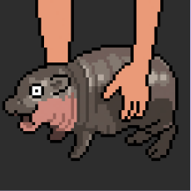
Suppose we want to take an image, and copy it to a new image object
import image
img = image.Image("pixel_moo.gif")
width = img.getWidth()
height = img.getHeight()
new_img = image.EmptyImage(width, height)
for row in range(height):
for col in range(width):
v = img.getPixel(col,row)
new_img.setPixel(col,row,v)
win = image.ImageWin("MooDeng", width, height)
new_img.draw(win)

Slide 8
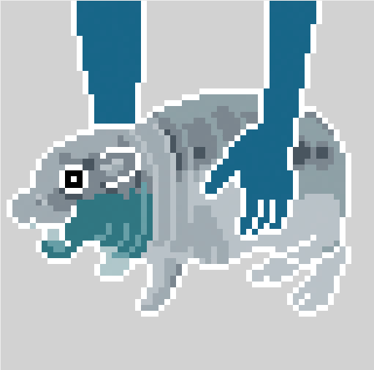
Suppose we want to take an image, and adjust the color
We can take the gif of Moo Deng on the left and invert the colors to make it look like an xray!
original
transformation
To replicate this xray, you’ll need to find RGB color intensities of each pixels and subtract those values from 255.

Slide 9
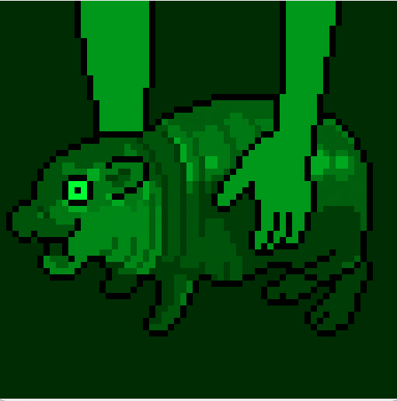
Green Moo Deng
We can also take an image and remove certain colors! Let’s take this image of Moo Deng and set all blue and red intensities to 0, leaving only the green intensities.
We will need to use a few new methods:
getPixel() will allow us to interact with a singular pixel
setRed() and setBlue() which take as their arguments a certain intensity. For this example, we want to set both of these to 0.
We then use setPixel() to save our changes.
original
transformation

Slide 10
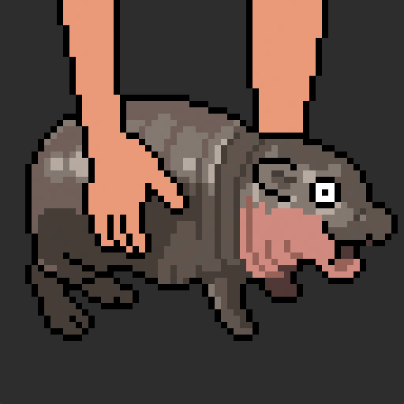
Flipped Moo Deng
We can also take an image and reflect it in a certain direction. Let’s take Moo Deng and reflect her horizontally.
We will need to use a few new methods:
getPixel() will allow us to interact with a singular pixel
We will need to go through each pixel and change it’s column using setPixel() to be its reflected coordinate.
Then we can substitute: pixel in the first column (col 0) get switched to the last column (width minus 1); pixel in second col switched to second to last col; ect.
width - 1
width - 1 - 2
col 0
width - 1 - 1
col 1
col 2
original
transformation
new_img.setPixel(____________,row,v)
width - 1 -col

Slide 11
rotate Moo Deng
We can also take an image and rotate it in a certain direction. Let’s take Moo Deng and rotate her 90 degrees clockwise
We will need to use a few new methods:
getWidth() and getHeight() to grab the width and height of our image
getPixel() will allow us to interact with a singular pixel
To do this, we’ll need to flip the new cols similarly to what we just saw with the flipped image,and then swap cols and rows in setPixel()
new_img.setPixel(____________,____,v)
width - 1 -row col
original
transformation

Slide 12
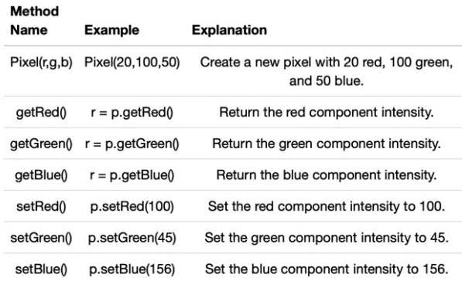
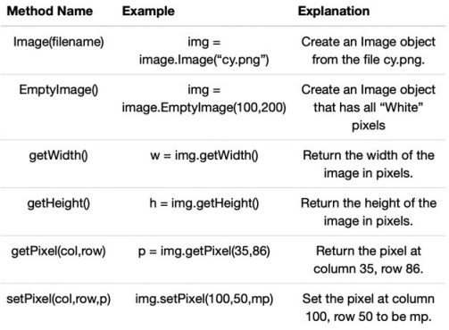
start on project 4
pixel methods
image methods

Slide 13

before next time
Finish worksheet
Read Project 4
Start Task 1 on Project 4

Slide 14
Note: you can have outer for loop with row and inner for loop with col, and vice versa.
Order typically matters when calling methods from the image module. Both getPixel and setPixel methods expect col in first argument and row in second
green Moo Deng
flipped Moo Deng
rotate Moo Deng
import image
img = image.Image("pixel_moo.gif")
width = img.getWidth()
height = img.getHeight()
new_img = image.EmptyImage(width, height)
for row in range(height):
for col in range(width):
v = img.getPixel(col,row)
v.setBlue(0)
v.setRed(0)
new_img.setPixel(col,row,v)
win = image.ImageWin("Green MooDeng", width, height)
new_img.draw(win)
import image
img = image.Image("pixel_moo.gif")
width = img.getWidth()
height = img.getHeight()
new_img = image.EmptyImage(width, height)
for row in range(height):
for col in range(width):
v = img.getPixel(col,row)
new_img.setPixel(width - 1 -col,row,v)
win = image.ImageWin("Flip MooDeng", width, height)
new_img.draw(win)
import image
img = image.Image("pixel_moo.gif")
width = img.getWidth()
height = img.getHeight()
new_img = image.EmptyImage(width, height)
for row in range(height):
for col in range(width):
v = img.getPixel(col,row)
new_img.setPixel(width-1-row,col,v)
win = image.ImageWin("Flip MooDeng", width, height)
new_img.draw(win)

Slide 15
this week
google sheet link
office hours today 3-4pm and TA help sessions 7-8
office hours Thursday 12:30-2

Slide 16
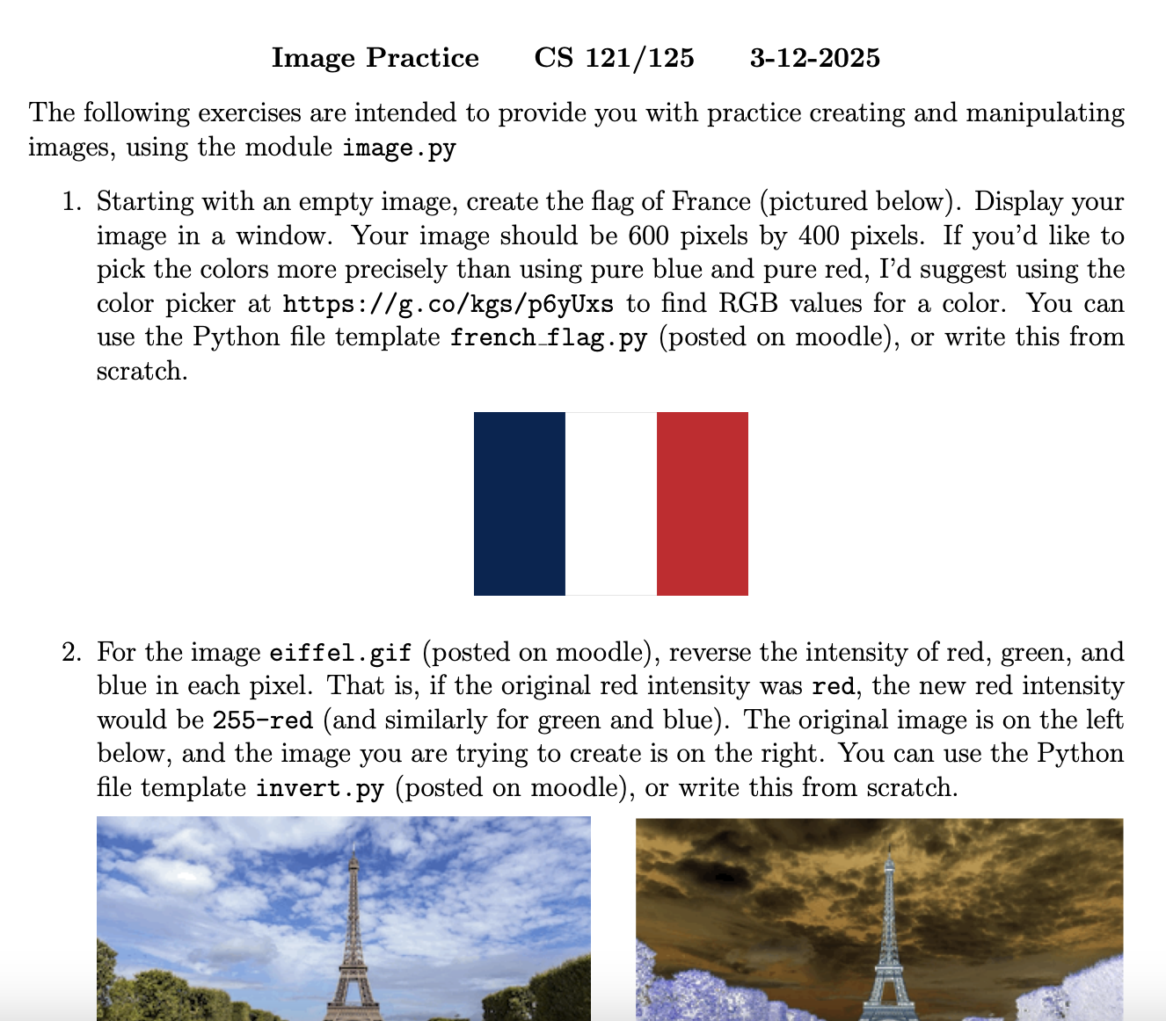
Practice with Images worksheet is up on Moodle (along with solutions)
For questions 1-3, grab a partner and a whiteboard marker and see if you are able to:
(1) outline the program with comments, and then
(2) fill in the Python code.
If you get stuck, consult previous slide decks or work you’ve done.
Our goal today is to be able to write some of these programs out by hand so that we are prepared for when we see these on a quiz.

Slide 17
pixel methods
image methods

